Slide 1
How will wireless 5G technology handle 1 000 times more data?
Emil Björnson
Associate Professor and Docent in Communication Systems

Slide 2
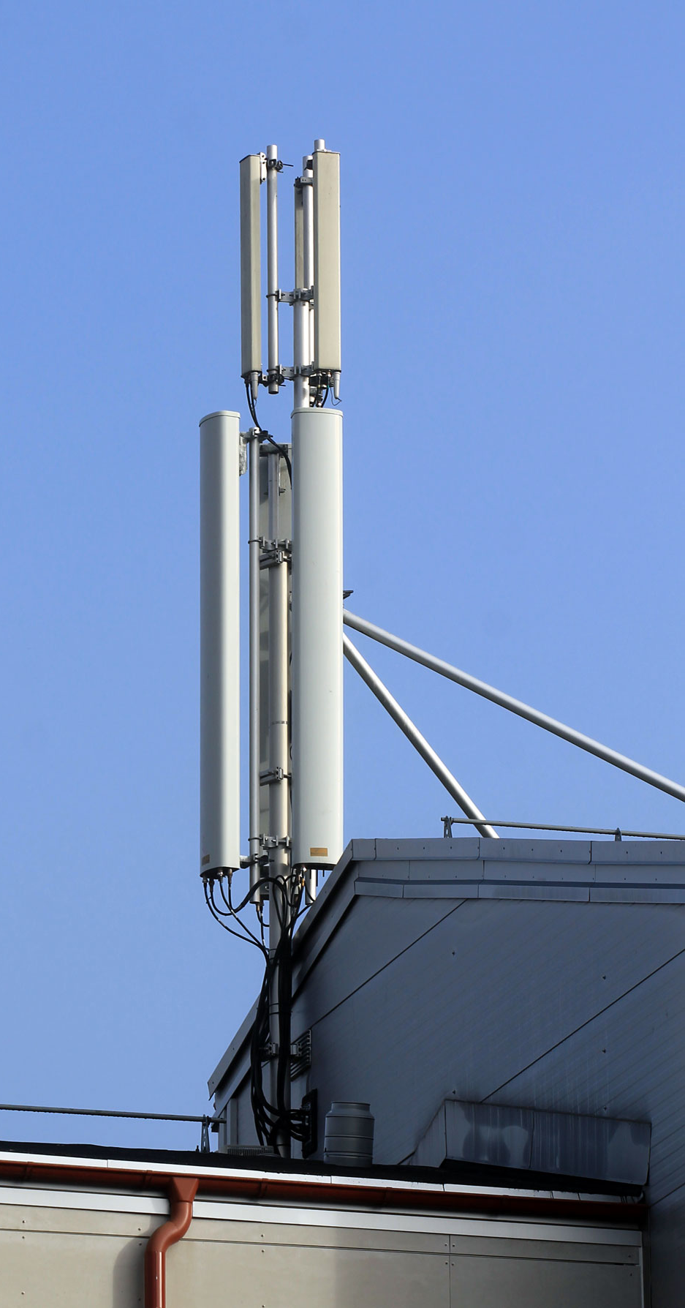
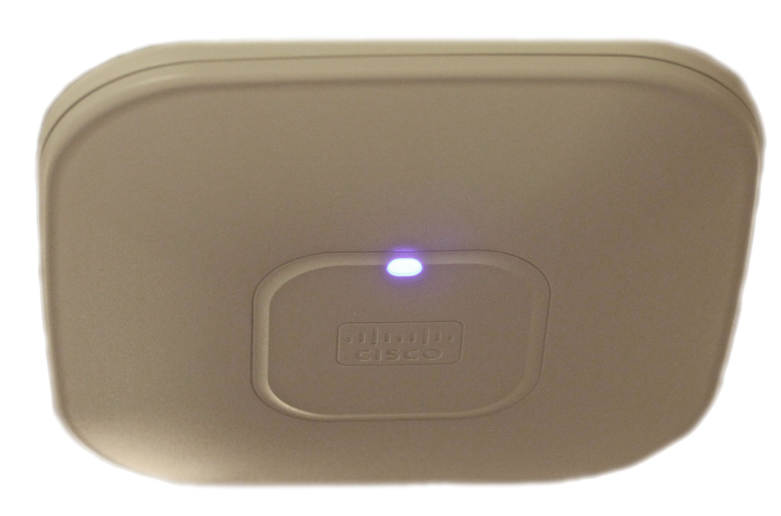
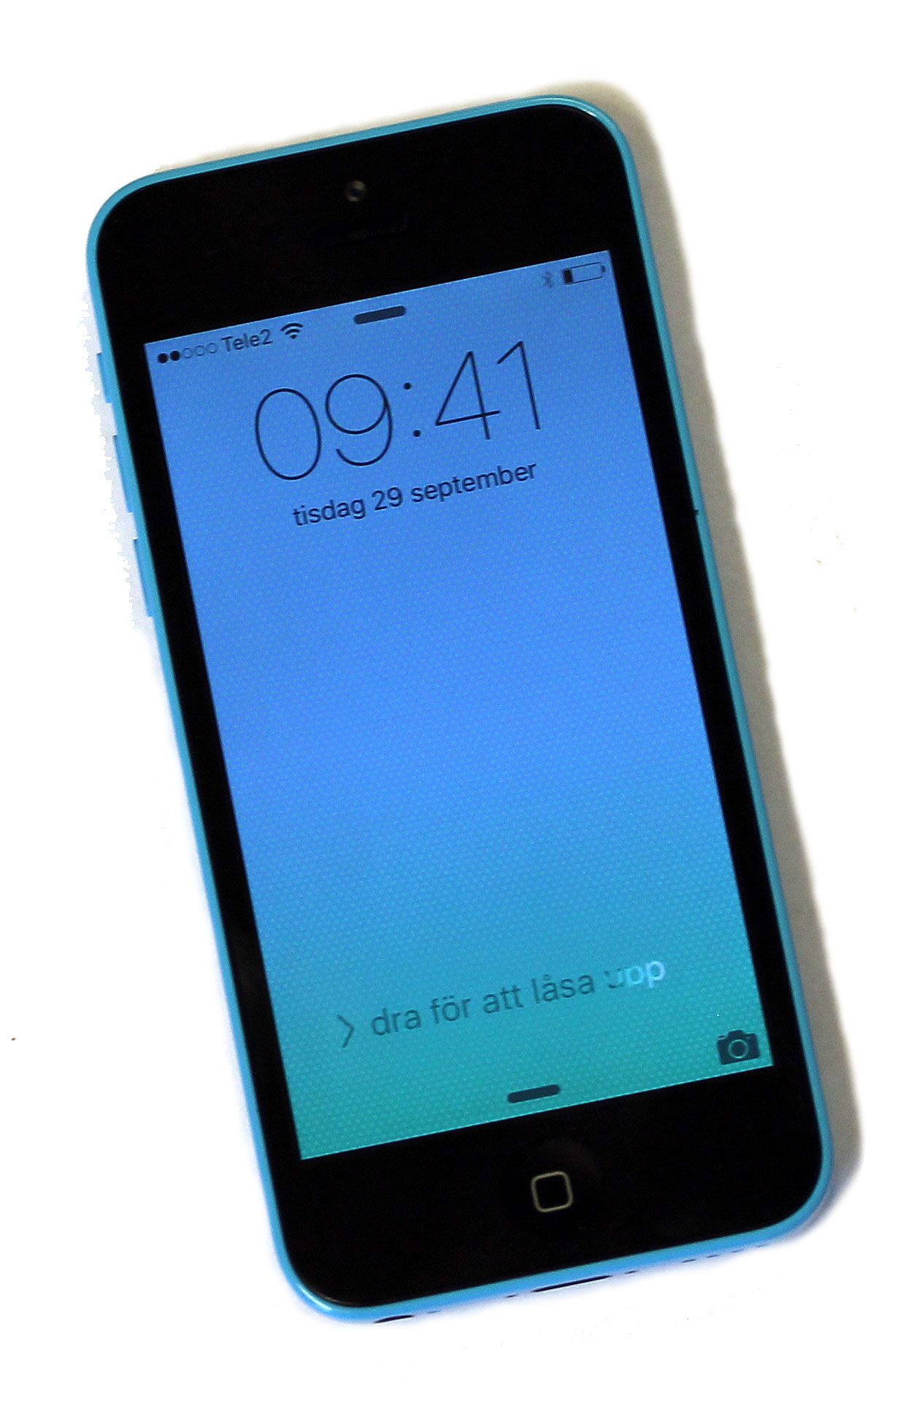
What is wireless communication?
AP: Base station
AP: WiFi
Transmission of information between
Access point (AP)
User
Digital: zeros and ones
Describes text, sound, images, …
User
Wireless transmission
(Electromagnetic signals)

Slide 3
Fast traffic growth
Voice call
Social networks
Video streaming
Next killer-app?
Wirelessly connected society
Consume more GB/month
New applications
Data traffic
50% annual increases
1000 times more until 2034
Requires new technology!
Gaming
6.5 GB/person/month
0.7 GB/person/month
Source: Ericsson Mobility Report, Nov. 2015

Slide 4
Generations of cellular technology
1G
2G
3G
4G
5G
1981
1991
2001
2010
2020?
Analog technology
Digital technology
Internet in your phone
Mobile broadband
Faster, 1000 times more data
More robust and energy efficiency

Slide 5
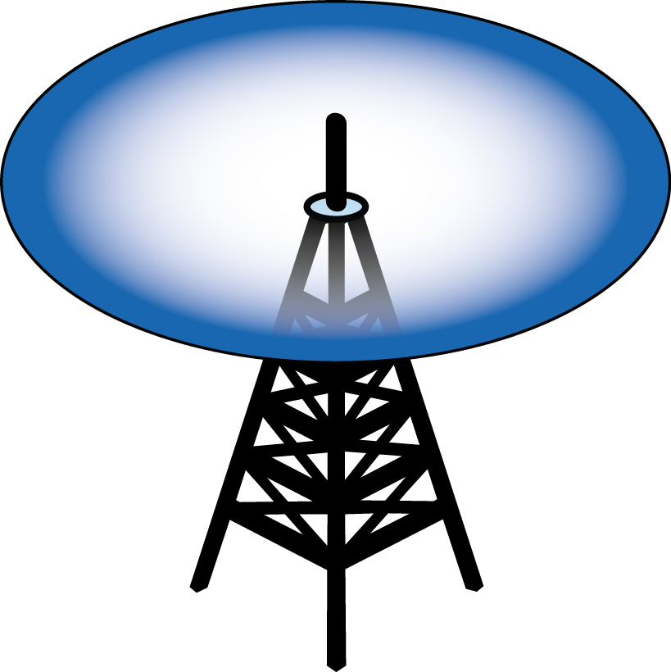
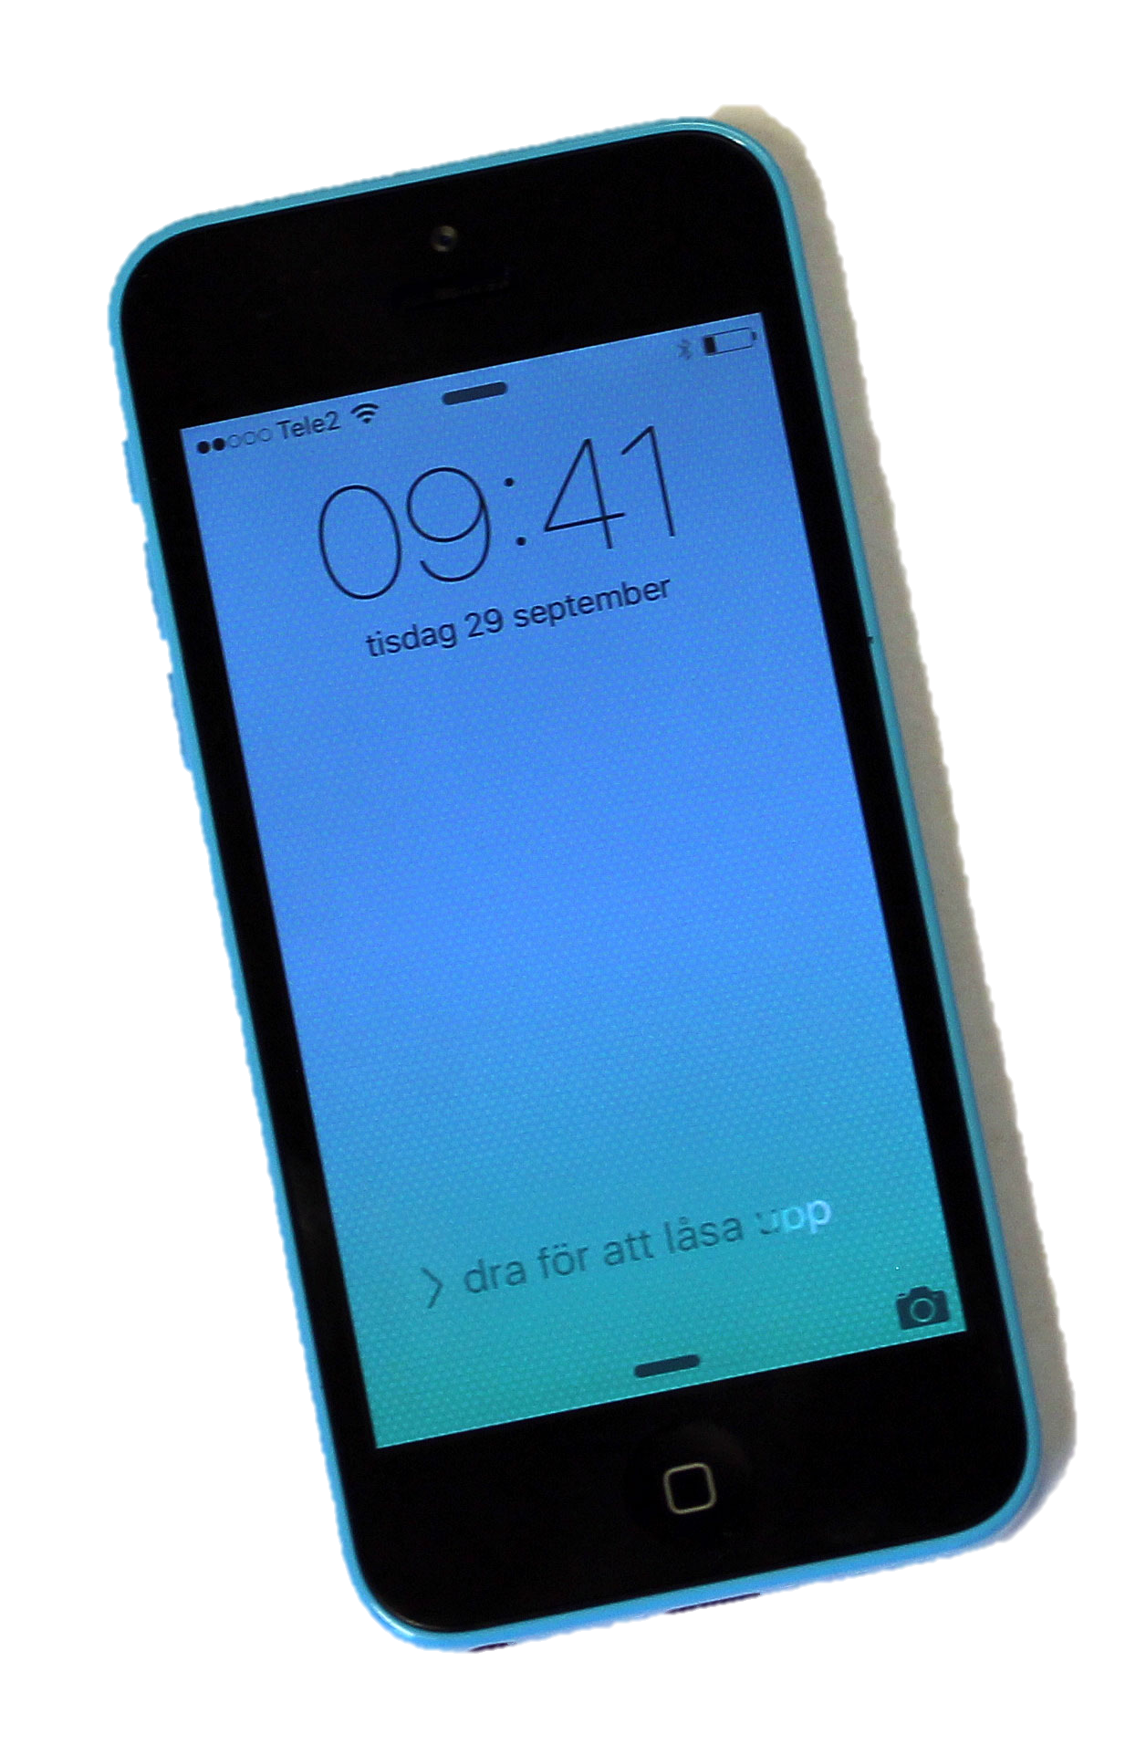
How does wireless technology work?
Electromagnetic signals
Antenna at access point
Antenna in cell phone
Think:
Flickering light bulp
Camera

Slide 6
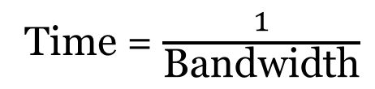
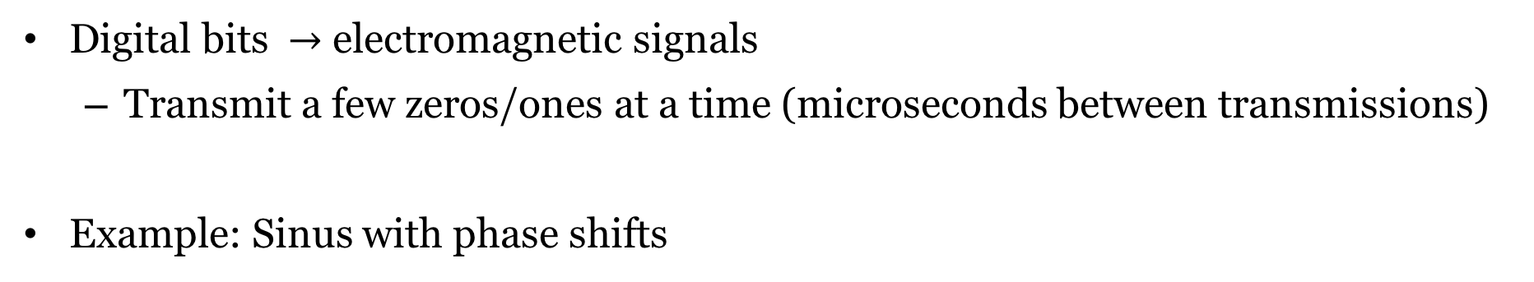
Digital communication
00
10
11
01
Digital bits $→$ electromagnetic signals
Transmit a few zeros/ones at a time (microseconds between transmissions)
Example: Sinus with phase shifts
Phase shifts
Signals
01
11
00
t
10
Time = $\frac{1}{\text{Bandwidth}}$

Slide 7
Example: Digital data transmission
Phase shifts
Signals
01
11
00
t
10

Slide 8
Example: Digital data transmission
Phase shifts
Signals
01
11
00
t
10
Sequence of bits to be transmitted:
00
00
00
10
10
10
11
11
11
01
01
01
11
00
01
10

Slide 9
Example: Digital data transmission
Phase shifts
Signals
01
11
00
t
10
Sequence of bits to be transmitted:
00
10
11
01
11
11
11
00
00
00
01
01
01
10
10
10

Slide 11
Challenge of communication
Transmitted signal
Noise and distortion
Received
signal
Research problem: Transmit as much data as possible per second

Slide 12
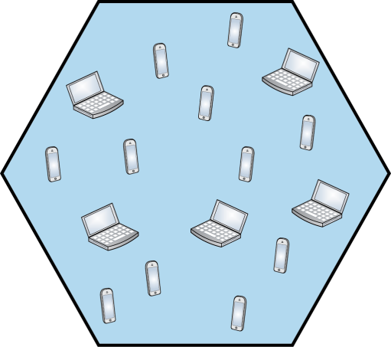
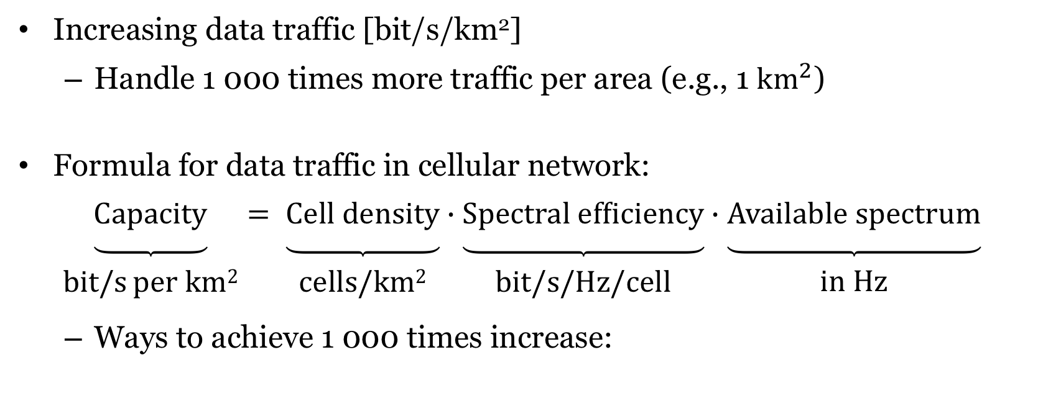
How will 5G technology handle 1 000 times more data?
Increasing data traffic [bit/s/km²]
Handle 1 000 times more traffic per area (e.g., 1 $\text{k}{\text{m}}^{2}$)
Formula for data traffic in cellular network:
$\underset{\begin{matrix} \\ \text{bit}\text{/}\text{s} \text{per} \text{km}\text{2}\end{matrix}}{\underbrace{\text{Capacity}}}= \underset{\begin{matrix} \\ \text{cells}\text{/}\text{km}\text{2}\end{matrix}}{\underbrace{\text{Cell} \text{densit}\text{y}}}∙\underset{\begin{matrix} \\ \text{bit}\text{/}\text{s}\text{/}\text{Hz}\text{/}\text{cell}\end{matrix}}{\underbrace{\text{Spe}\text{c}\text{tral} \text{eff}\text{iciency}}}∙\underset{\begin{matrix} \\ \text{in} \text{Hz}\end{matrix}}{\underbrace{\text{Available} \text{spe}\text{c}\text{trum}}}$
Ways to achieve 1 000 times increase:
 | Higher cell density | Higher spectral efficiency | More spectrum
Nokia (2011) | 10x | 10x | 10x
SK Telecom (2012) | 56x | 6x | 3x

Slide 13
Higher cell density
First factor

Slide 14
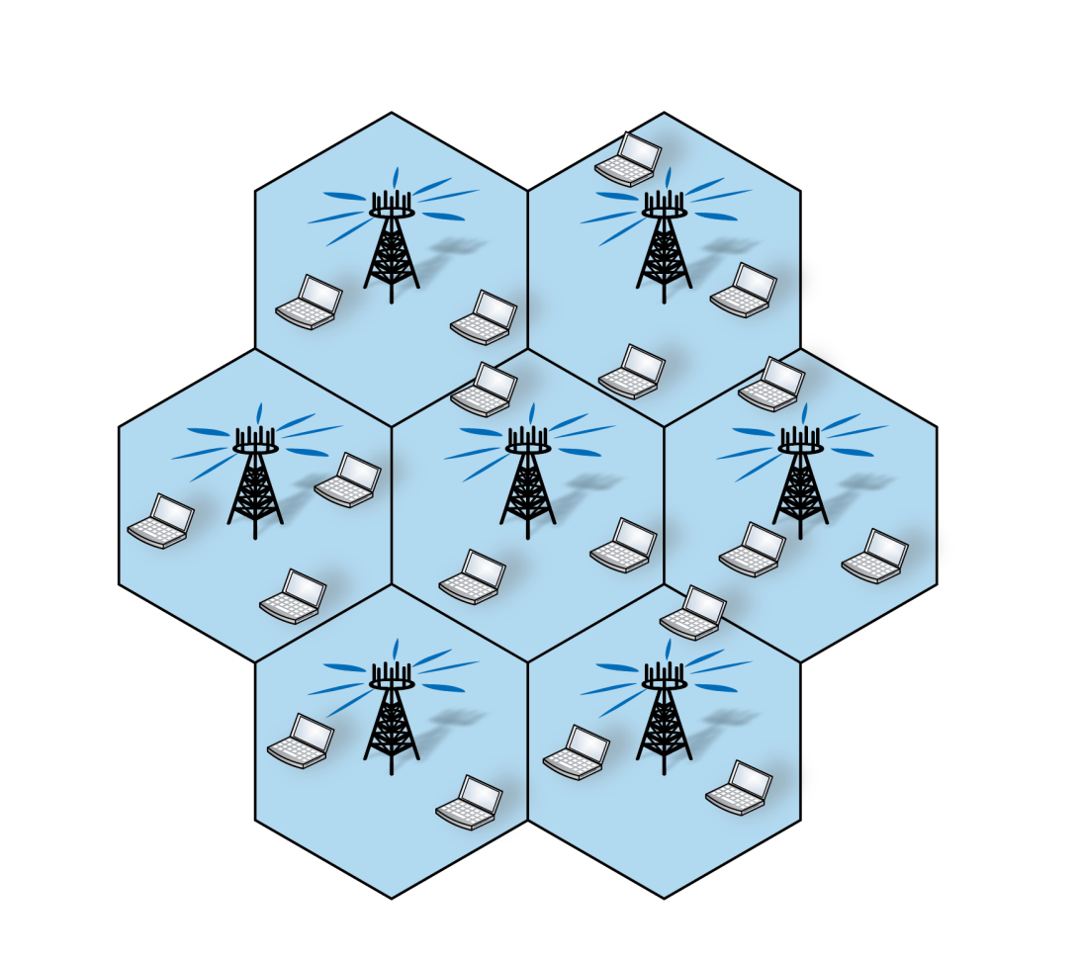
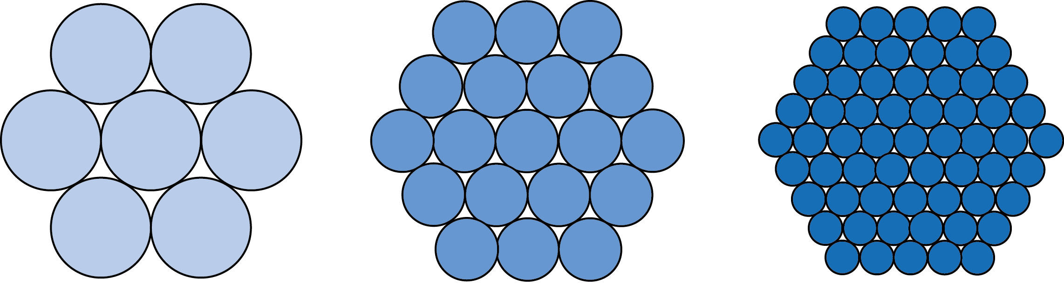
Higher cell density
Cellular networks
Coverage area divided into cells
One access point per cell – serves the users in the cell
Denser deployment of access points
Shorter distance: reduce power
Challenge: Interference
Higher capacity if bit/s/cell maintained
Denser and denser

Slide 15
Higher spectral efficiency
Second factor

Slide 16
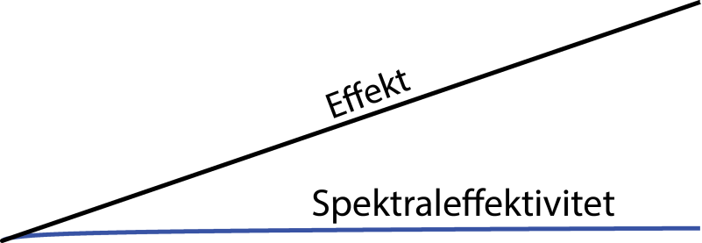
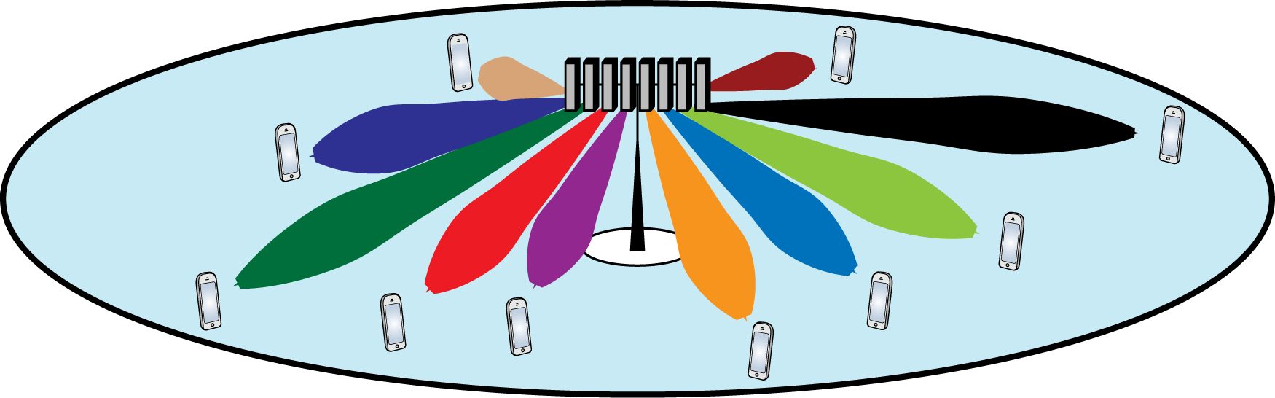
Higher spectral efficiency [bit/s/Hz]
Spectral efficiency from information theory:
Expensive to increase: Each doubling require 17 times more power!
Solution: Many simultaneous transmissions, directed towards the users
1 antenna
MIMO-technology: 100 antennas

Slide 17
More frequency spectrum
Third factor

Slide 18
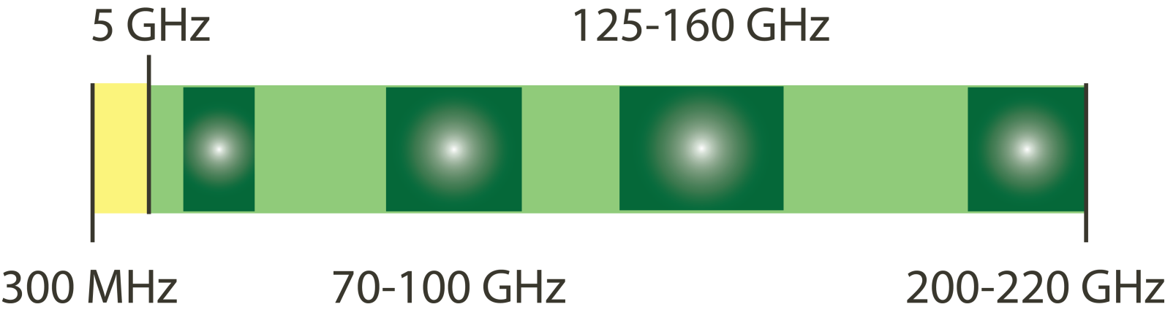
More frequency spectrum
More spectrum
Reduced time per transmission
Are there any unused spectrum?
Much has already been allocated
580 MHz to cellular, 540 MHz to WiFi (Sweden)
Many GHz of unused spectrum at mm-wave frequencies (30-300 GHz)
Challenges: Signal propagation very differently Design of new hardware
2G/3G/4G/WiFi, TV, military use
New applications for communication

Slide 19
Summary

Slide 20
How will 5G technology handle 1 000 times more data?
10x?
Higher cell density
More access points per km²
Higher spectral efficiency
Direct signals towards many users
More frequency spectrum
More transmission per second
Use much higher frequencies
20x?
5x?
= 1000

Slide 21
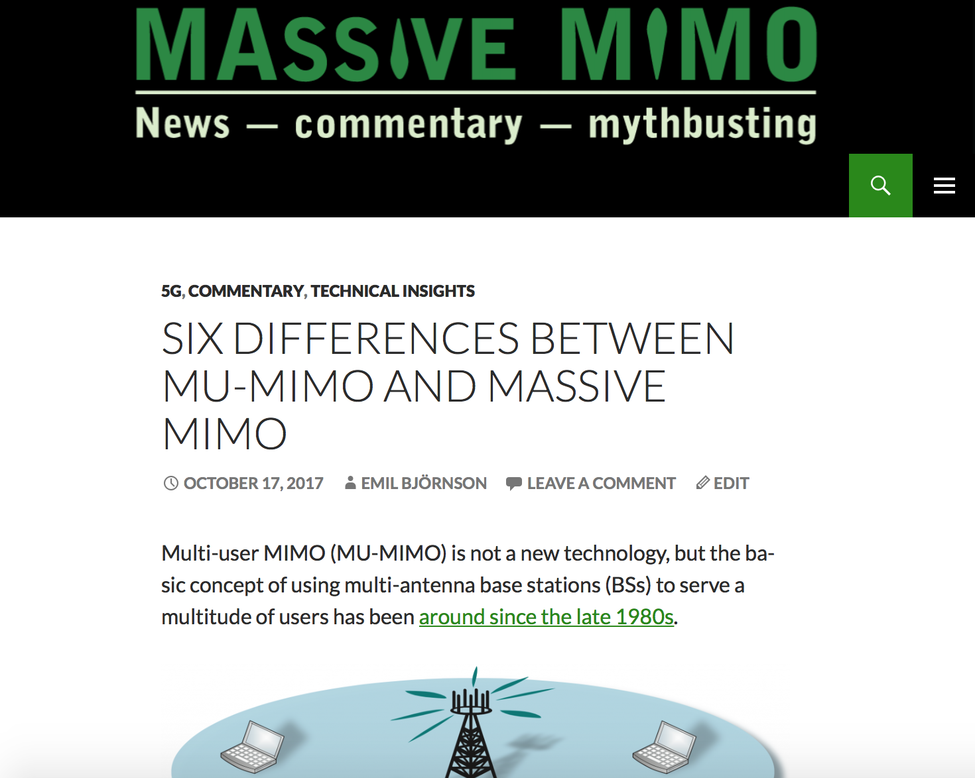
Want to know more about 5G?
Subscribe to our YouTube channel
Follow the Massive MIMO blog:
massive-mimo.net
Emil Björnson, Associate Professor in Communication Systems

